Slide 1
CARACAL-33
Annex VIII to CLP – workability amendment
15 January 2020
European Commission
DG GROW/D.2 - Chemicals
DG ENV/B.2 – Sustainable chemicals

Slide 2
Background
Regulation (EU) 2017/542 harmonising information to be submitted relating to emergency health response = ‘Annex VIII to CLP’
Adopted in 2017 on condition that claimed workability issues are studied and Regulation is amended if necessary
Workability study
June 2018 – June 2019
Workability amendment

Slide 3
Workability amendment - Timeline
CASG-ATP 25 September 2019
  ICG: Presentation of Interchangeable Component Group (ICG) solution
  MiM: Discussion solution for MiMs ending up in consumer products not subject to Art. 45
  Remaining issues:
    Construction products (cement, concrete, gypsum) and petroleum products
    Bespoke paints
CARACAL 6 November 2019
  General support ICG with suggestions for further refinement
CARACAL 15 January 2020

Slide 4
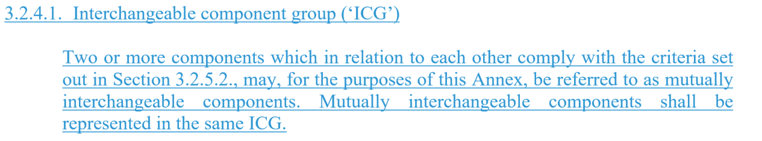
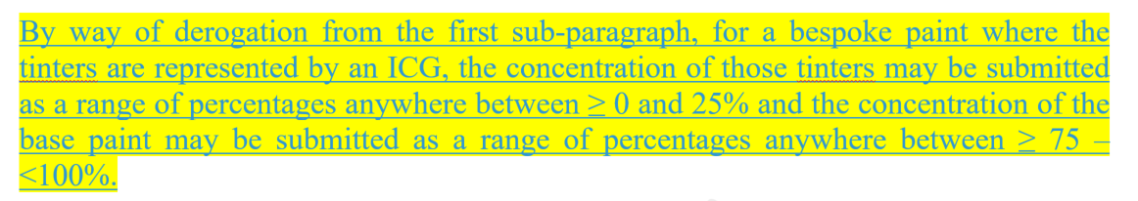
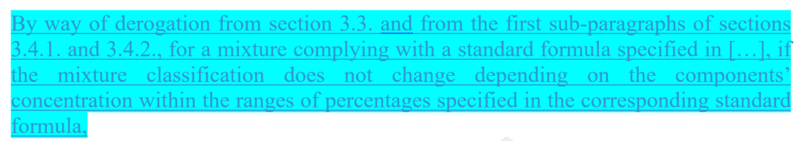
Working document – draft legal text
Track changes = ICG and MiM (Art. 45) solution (+ other non-workability related changes)
Yellow highlights = bespoke paints solution
Blue highlights = ICG and MiM (Art. 45) solution

Slide 5
Mixtures defined by standard formulas

Slide 6
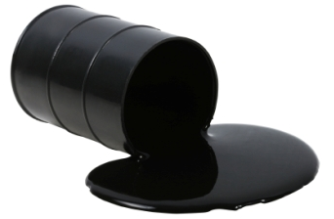


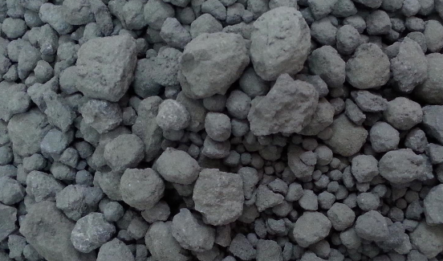
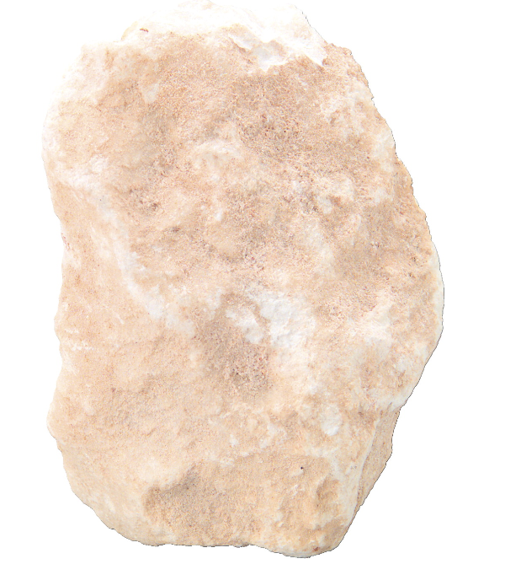
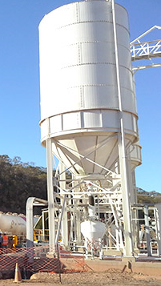
The issue
Technical standards
Raw materials of natural origin
Continuous production process
Exact composition of mixture at any given time unknown
Variations in components’ concentration exceeds concentration band widths in Tables 1 and 2 of Annex VIII
Storage
in one
silo

Slide 7


Proposed solution – industry (1)
Define standard formulas, specifying mixture composition:
  component identity
  component concentration
Mixtures with a composition corresponding to a standard formula can be notified according to that formula and deviate from the default Annex VIII requirements
Standard formulas proposed by 4 sectors:
  Cement sector
  Gypsum sector
  Concrete sector
  Petroleum sector
Discussion paper
Annex II

Slide 8
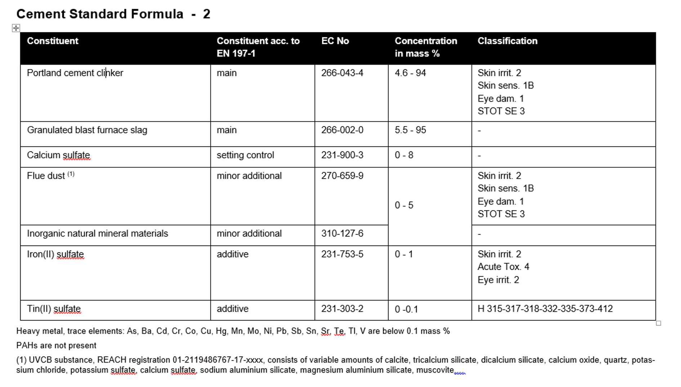
Proposed solution – industry (2)
! Overview of proposed standard formulas in discussion paper – Annex II

Slide 9
Proposed solution – industry (3)
 | Cement | Concrete | Gypsum | Petroleum
Basis for standard formulas | EN 197 (common cements) EN 14647 (calcium aluminate cement) EN 413-1 (masonry cement) | EN 206 | EN 13279 | SDS of sector members
Number of standard formulas proposed | 20 | 2 (identical) | 1 | 18

Slide 10
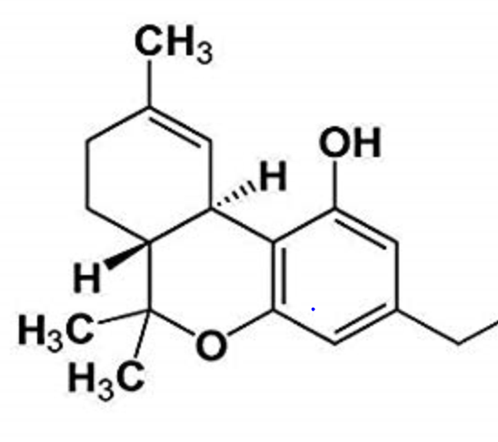


Proposed solution – COM’s draft legal text (1)
Define standard formulas, specifying composition:
  component identity
  component concentration
Mixtures with a composition corresponding to a standard formula can be notified according to that formula - and deviate from a number of Annex VIII requirements:
  Components’ identity
  Components’ concentration
  Submission update
  UFI update
  IF
  Mixture classification does not change depending on the components’ concentration within the ranges specified in the standard formula, and

Slide 11
Proposed solution – COM’s draft legal text (2)
Derogation - distinction:
Information in standard formula is not less detailed than information in Safety Data Sheet
Information in standard formula is less detailed than information in Safety Data Sheet
Standard formula vs. SDS

Slide 12
Proposed solution – standard formula vs. Safety Data Sheet
 | Cement | Concrete | Gypsum | Petroleum
Basis for standard formulas | EN 197 (common cements) EN 14647 (calcium aluminate cement) EN 413-1 (masonry cement) | EN 206 | EN 13279 | SDS of sector members
Number of standard formulas proposed | 20 | 2 (identical) | 1 | 18
Degree of coverage of sector products (COM analysis) | 100%? | Concretes not falling in the scope of EN 206 (aerated concrete, foamed concrete, concrete with density less than 800 kg/m3, refractory concrete)? | Gypsum-based building plaster (B2) gypsum-lime building plaster (B3) not covered | 100% (taking into account that ICG use will also account for a number of products)
Cement, concrete, gypsum:
How does information in submission relate to information in SDS (concerning composition)?
Petroleum:
Mixtures with different classification covered by 1 notification
Information in notification will in most (if not all) cases be less detailed than SDS?

Slide 13
Proposed solution – COM’s draft legal text (3)
  Components’ identity
  Components’ concentration
Derogation from | Instead
Section 3.3.: all mixture components present >= 0,1% (hazardous) or > 1% (non-hazardous) shall be indicated | Allowed to indicate only the mixture components specified in the standard formula/Safety Data Sheet*
Sections 3.4.1. and 3.4.2. with Tables 1 and Tables 2, specifying the maximum widths of the concentation ranges to be used in a submission | Allowed to provide the concentration range as specified in the standard formula/Safety Data Sheet*
*whichever is more detailed

Slide 14
Proposed solution – COM’s draft legal text (4)
  Submission update
  UFI update
Derogation from | Instead
Section 4.1, fourth indent: Update required if addition, substitution, or deletion of one or more components in the mixture change in the concentration of a component beyond allowed ranges change in exact concentration beyond allowed limits | Information submitted according to standard formula: update if mixture composition no longer corresponds to standard formula Information submitted according to SDS: update if SDS section 3 is updated
Section 5.2. A new UFI is to be created if there is a change in the composition of the mixture fulfilling 4.1 (a), (b) or (c) | A new UFI is to be created if Mixture composition no longer corresponds to standard formula*, or Update of submission is required following update of SDS section 3**
*, ** where the original composition was submitted according to standard formula(*) or SDS(**)

Slide 15
Proposed solution – COM’s draft legal text (5)
  3.5. Mixtures complying with standard formulas
By way of derogation from section 3.3. and from the first sub-paragraphs of sections 3.4.1. and 3.4.2., for a mixture complying with a standard formula specified in […], if the mixture classification does not change depending on the components’ concentration within the ranges of percentages specified in the corresponding standard formula,
  if the information on composition in the standard formula is not less detailed than that contained in Section 3 of the Safety Data Sheet in accordance with Annex II to Regulation (EC) No 1907/2006, the identity and concentration of all the mixture’s components may be submitted as specified in the standard formula,
  If the information on composition in the standard formula is less detailed than the Safety Data Sheet, and if additional information on the composition is rapidly available on request in emergencies in accordance with section 1.3, the information on the identity and concentration of all the mixture’s components contained in Section 3 of the Safety Data Sheet shall be given.

Slide 16
Proposed solution – COM’s draft legal text (6)
  4. SUBMISSION UPDATE
  4.1.
  Where one of the following changes applies to a mixture in an individual or group submission, submitters shall provide a submission update before placing that mixture, as changed, on the market:
  – […]
  – if a change in the composition of the mixture fulfils one of the following conditions:
  (a) addition, substitution, or deletion of one or more components in the mixture that shall be indicated in accordance with section 3.3;
  (b) change in the concentration of a component in the mixture beyond the concentration range provided in the original submission;
  (c) the exact concentration of a component was provided in accordance with sections 3.4.1. or 3.4.2., and a change occurs to that concentration beyond the limits identified in Table 3.
  By way of derogation from the fourth indent, a submission update for mixtures complying with any of the standard formulas in […] is required when the composition of the mixture changes in such a manner that the mixture does no longer comply with the standard formula. For mixtures where the information on composition is provided based on the Safety Data sheet in accordance with section 3.5. a submission update is required when Section 3 of the Safety Data Sheet is updated.

Slide 17
Conceptual solution vs specific standard fomulas
 | Cement | Concrete | Gypsum | Petroleum
Basis for standard formulas | EN 197 (common cements) EN 14647 (calcium aluminate cement) EN 413-1 (masonry cement) | EN 206 | EN 13279 | SDS of sector members
Number of standard formulas proposed | 20 | 2 (identical) | 1 | 18
Degree of coverage of sector products (COM analysis) | 100%? | Concretes not falling in the scope of EN 206 (aerated concrete, foamed concrete, concrete with density less than 800 kg/m3, refractory concrete)? | Gypsum-based building plaster (B2) gypsum-lime building plaster (B3) not covered | 100% (taking into account that ICG use will also account for a number of products)?
Do the specific standard formulas provide sufficient information on composition for emergency health response?
We need your expertise and input!!
Spefic standard formulas are collated in Annex II of the discussion paper

Slide 18
Bespoke paints

Slide 19



The issue
Bespoke paints = colours formulated on demand at point of sale
Very high number of possible different colours
  number of pre-emptive submissions to be made almost infinitely large, or
  notification of particular paint would have to be made on the spot, by the retailer, when paint is formulated
  very high adminstrative burden, while many colours may never be placed on the market

Slide 20
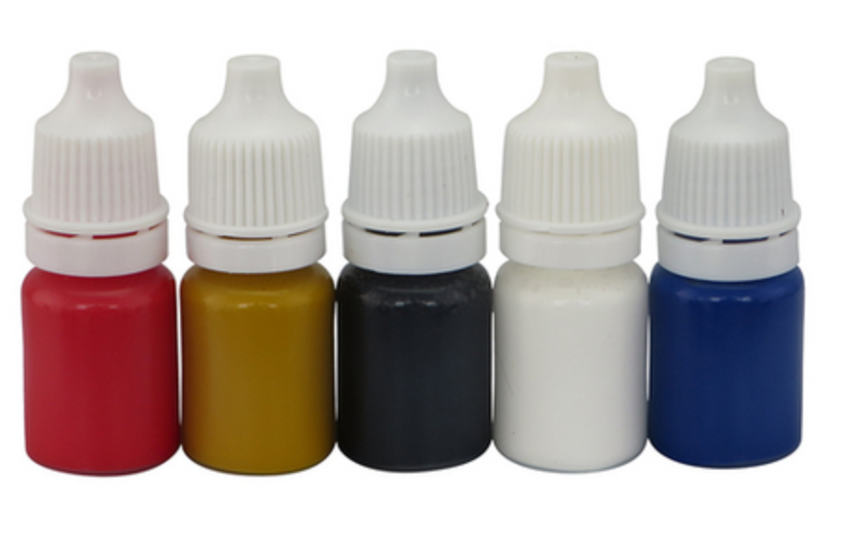
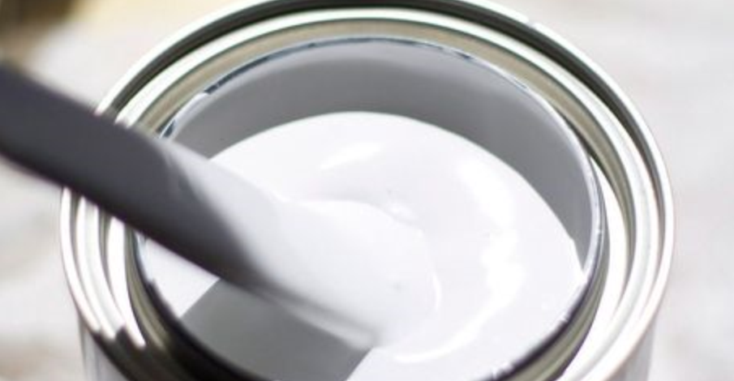
Proposed solution - COM
Bespoke paint = base paint + tinters
Base paint
Tinters
N1
UFI1
N3
UFI3
Nn
UFIn
Notification
N2
UFI2
N4
UFI4

Slide 21

Proposed solution - COM
Bespoke paint
Notification
Name: ‘Red paint’
Classification: Skin Sens.
Composition:
Comp. | Class. | Conc.
Base paint | Skin sens. | x%
‘Tinters’ | Skins Sens. | y%
Tinter 1
Tinter 2
Tinter 3
…
Tinter n

Slide 22
Proposed solution - COM
Bespoke paint
MiM
Notification
Base paint
Name: ‘Red paint’
Classification: Skin Sens.
Composition:
Comp. | Class. | Conc.
Base paint | Skin sens. | x%
‘Tinters’ | Skins Sens. | 10%
Tinter 1
Tinter 2
Tinter 3
…
Tinter n
Notification

Slide 23
Proposed solution - COM
Bespoke paint
Notification
Name: ‘Red paint’
Classification: Skin Sens.
Composition:
Comp. | Class. | Conc.
Base paint | Skin sens. | x%
‘Tinters’ | Skins Sens. | 10%
Tinters
Tinter 1
Tinter 2
Tinter 3
…
Tinter n
N1
UFI1
N3
UFI3
Nn
UFIn
N2
UFI2
N4
UFI4

Slide 24
Proposed solution - COM
Bespoke paint
Notification
Name: ‘Red paint’
Classification: Skin Sens.
Composition:
Comp. | Class. | Conc.
Base paint | Skin sens. | x%
‘Tinters’ | Skins Sens. | y%
≈ ICG:
‘tinters’ covers all tinters
same technical function (‘tinter’)
total concentration covered by ICG < 25%
Tinter 1
Tinter 2
Tinter 3
…
Tinter n

Slide 25
Proposed solution - COM
Bespoke paint
Notification
Name: ‘Red paint’
Classification: Skin Sens.
Composition:
Comp. | Class. | Conc.
Base paint | Skin sens. | x%
‘Tinters’ | Skins Sens. | y%
75 – 100%
0-25%
Tinter 1
Tinter 2
Tinter 3
…
Tinter n

Slide 26
Draft legal text
Define ‘bespoke paint’
Notification of mixtures that are bespoke paints can deviate from a number of Annex VIII requirements:
  Components’ identity
  Components’ concentration

Slide 27
Draft legal text (1)
  Components’ identity
  Components’ concentration
Derogation from | Instead
Section 3.2.4.2. - conditions for mutual interchangeability: Same technical function Same classification at component level Same acute tox effects through same MoA Same classification at final mixture level | Same technical function (tinter) Incorporated in bespoke paint Total concentration <= 25% Submission for bespoke paint only contains 1 ICG representing tinters
Sections 3.4.1. and 3.4.2. with Tables 1 and Tables 2, specifying the maximum widths of the concentation ranges to be used in a submission | Tinters: concentration range anywhere between >= 0 and <25% Base paint: concentration range anywhere between >= 75 and < 100%

Slide 28
Draft legal text (2)
Definitions
(…)
‘Base paint’ means a mixture used to form the
foundation for a paint.
‘Tinter’ means a substance or mixture used to colour a
paint.
‘Bespoke paint’ means a paint which is formulated at the
point of sale, on an individual and one-off demand by a
specific consumer or professional user, by combining solely
a base paint and one or more tinters.

Slide 29
Draft legal text (3)
3.2.4.2. Conditions for components to be mutually interchangeable
[…]
By way of further derogation from 3.2.4.2.(a), for tinters in a bespoke paint it suffices that their total concentration does not exceed 25% and the submission for the bespoke paint contains only one ICG representing tinters.
3.4.1. Hazardous components of major concern for emergency health response and preventative measures
[…]
By way of derogation from the first subparagraph, for a bespoke paint where the tinters are represented by an ICG, the concentration of those tinters may be submitted as a range of percentages anywhere between >= 0 and < 25% and the concentration of the base paint may be submitted as a range of percentages anywere between >= 75 and < 100%

Slide 30
Interchangeable component group

Slide 31

Mutually interchangeable components
= components which are different, but sufficiently similar to be considered one and the same component (toxicologically)
Several conditions to be fulfilled
No obligation to categorise components which fulfill the obligations as mutually interchangeable components, but if you decide to do so, all mutually interchangeable components shall be covered by one and the same interchangeable component group (ICG)

Slide 32



Example – ‘same’ component, different suppliers
Final mixture
MiM
Comp. 1
Comp. 2
Comp. A 50%
Comp. 3
Comp. B 30%
Comp. C 20%
COMP. C | Supplier 1 | Supplier 2 | Supplier 3
Comp. 1 | 90% | 90% | 90%
Comp. 2 (Skin Sens) | 7% | 9% | 5%
Comp. 3 (Skin Sens) | 3% | 1% | 5%
Classific. | Skin Sens. | Skin Sens. | Skin Sens.
>= 1 - < 10%
Max width = 1% unit (Table 3.4.1.)
3 different MiMs following Annex VIII

Slide 33
Interchangeable component group
3.2.4 Interchangeable component group (‘ICG’)
Two or more components which in relation to each other comply with the criteria set out in Section 3.2.5.2,, may, for the purposes of this Annex, be referred to as mutually interchangeable components. Mutually interchangeable components shall be and represented in the same ICG.
Each interchangeable component shall be identified in accordance with section 3.2.1 or 3.2.2, as applicable.
3.2.5. Conditions for components to be mutually interchangeable
Text version 6 November 2019 | Text version 15 January 2020
Interchangeable components: Same hazard classification Same or very similar section 11 SDS | Interchangeable components: Same hazard classification Same technical function Same acute tox effects, produced by same MoA Same or very similar section 11 SDS
All possible final mixtures: Same hazard identification Same additional information in section 2 Part B | All possible final mixtures: Same hazard identification Same additional information in section 2 Part B

Slide 34
Interchangeable component group
3.2.4.2. Conditions for components to be mutually interchangeable
By way of derogation from 3.2.4.2. (a), for mutually interchangeable components classified only for skin corrosion, skin irritation, eye damage, eye irritation, aspiration toxicity, or respiratory or skin sensitisation, or a combination thereof, it suffices that only their classification for health and physical hazards (hazard class and category) is identical, provided that in addition:
- the pH of all mutually interchangeable components classified for skin corrosion, skin irritation, eye damage, or eye irritation must be either acidic, neutral or alkaline, and
- a maximum of 5 interchangeable components classified for skin or respiratory sensitisation is included in the submission.

Slide 35
Backup slides

Slide 36



Example 1 – ‘same’ component, different suppliers (2)
Supplier 1
MiM. C1
MiM C???
Supplier 2
MiM. C2
Supplier 3
MiM. C3

Slide 37

Example 1 – ‘same’ component, different suppliers (3)
Notification
Name: ‘Mixture X’
Classification: Skin Sens.
Composition:
Comp. | Class. | Conc.
‘A’ | Not classified | 50%
‘B’ | Not classified | 30%
ICG 1 | Skins Sens. | 20%
Each C identified following 3.2.2
‘C1’ | ‘C2’ | ‘C3’
Justification, not to be submitted
Classification of C1, C2, C3 is the same
Technical function of C1, C2, C3 is the same
Any acute tox effects caused are the same for C1, C2, C3, with the same MoA
At ‘Mixture X’ level, hazards identification and additional information is always the same, regardless whether C1, C2 or C3 is actually present

Slide 38


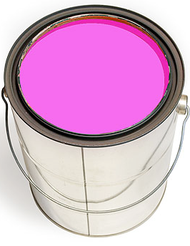

Example 2 – different components, but (toxicologically) the same (1)
Composition | Mixture ‘G’ | Mixture ‘P’ | Mixture ‘R’
45% | A | A | A
45% | B | B | B
10% | G | P | R
Classific. | Skin Sens. | Skin Sens. | Skin Sens.

Slide 39
Example 2 – different components, but (toxicologically) the same (1)
Notification
Name: ‘Mixture G’, ‘Mixture P’, ‘Mixture R’
Classification: Skin Sens.
Composition:
Comp. | Class. | Conc.
‘A’ | Not classified | 45%
‘B’ | Not classified | 45%
ICG 1 | Skins Sens. | 10%
‘G’ | ‘P’ | ‘R’
Justification, not to be submitted
Classification of G, P, R is the same
Technical function of G, P, R is the same
Any acute tox effects caused are the same for G, P, R, with the same MoA
At ‘Mixture X’ level, hazards identification and additional information is always the same, regardless whether G, P or R is actually present
Classification of G, P, R is the same
SDS section 11 of G, P and R is (virtually) the same
At ‘Mixture’ level, hazards identification and additional information is always the same, regardless whether G, P or R is present

Slide 40
Conclusions after Café discussion - standard formulas (1)
Acceptability of COM proposal
  Generally yes
  Concerns for petroleum products
Sufficient information?
  Standards should provide more information than SDS (what is defined as 'more'?)
  Working group needed to assess whether sufficient
  → COM: there will be no working group; feedback to be provided by MS/PC

Slide 41
Conclusions after Café discussion - standard formulas (2)
Questions/issues
  Who defines/approves standard formulas?
  How to update/change/include (new) standard formulas?*
  Transparency and inclusion: standard formulas should be possible also for other sectors
  Increased complexity → search for simplification possibilities (for IT, and poison centres)
  How will this be implemented in IT?
  Request for postponement for affected products
  *Some sectors: update necessary only once per 5 – 10 years. Petroleum sector: 1-2/year.
  → Frame in legal text + separate list of concrete standards?

Slide 42
Conclusions after Café discussion - bespoke paints (3)
Acceptability of COM proposal for bespoke paints
  Ind: OK
  MS/PC: preference for FR proposal
Questions/issues
  Ind: toner issue not resolved
  MS/PC: toner issue not demonstrated

Slide 43
Additional questions afternoon session
What is the degree of coverage of your sector's products by the proposed standard formulas?
In what proportion of cases will the SDS provide more/more specific information than the standard formula?
Should specification of composition according to standard formula be allowed for MiMs in a mixture (for the 4 sectors defined)?

Slide 44
Conclusions afternoon session – standard formulas
Cement
Proposed standard formulas does cover 100% of the products
Standard formulas more specific than SDS

Slide 45
Conclusions afternoon session – standard formulas
Concrete
Proposed standard formulas cover 99% of the products
Standard formulas more specific than SDS ('doubts?')
TO DO: industry to provide alternative standard formula for the 1% of products that is not covered?

Slide 46
Conclusions afternoon session – standard formulas
Gypsum
Proposed standard formula covers ca. 99%
In most cases SDS more specific than standard formula → ind. ok to notify according to SDS
TO DO: solution to be found for B2 and B2
TO DO (COM): Clarify in draft text possbility to cover only part of mixture (MiM) through a standard formula, while the final mixture is notified acccording to standard Annex VIII requirements

Slide 47
Conclusions afternoon session – standard formulas
Petroleum
Criteria needed for 'more specific' information (SDS vs. standard formula)
Need for PCs to have match in classification between notification (based on standard formula) and SDS
→ New proposal: 1 table, multiple UFIs with each UFI corresponding to specific classification on specific SDS
→ TO DO: new formulas to be provided by ind

Slide 48
Conclusions afternoon session – bespoke paints
TO DO: New proposal (COM to amend legal text)
  "FR solution" (no generic notification): No notification of final mixture, print the UFI of base paint (on can) + all tinters on label (on sticker)
  If total concentration of hazardous tinters present above x (5? 25?)%, then indicate the percentage range of tinter beside the UFI (Apply tables 1 and 2 for percentage ranges?)
  Include toners in same rules
TO DO (CARACAL):
  Define threshold concentration
  Decide how to apply to toners (default or threshold)

Slide 49
Conclusions afternoon session – ICG
Mode of action:
  Ind: information on mode of action not available to mixture formulators (confirmed by IE PC; intended to require only when available)
  Alternative suggestion = sameness of 'toxicological profile'
    Same target organ
    To be further elaborated in guidance
TO DO (ind): please send us your input for names (some input already received)
→ technical function + description meaningful for PCs

